Slide 1


大數據視覺化設計實務
歐陽振森 教授

Slide 2
CH1 Introduction
http://hscc.cs.nthu.edu.tw/~sheujp/module/wireless_network_2025/Smart_Trash_Can_Design_and_Application.pdf
Big Data Visualization
Methods, Techniques, and Tools for Big Data Visualization

Slide 3


Big Data Analysis

Slide 4
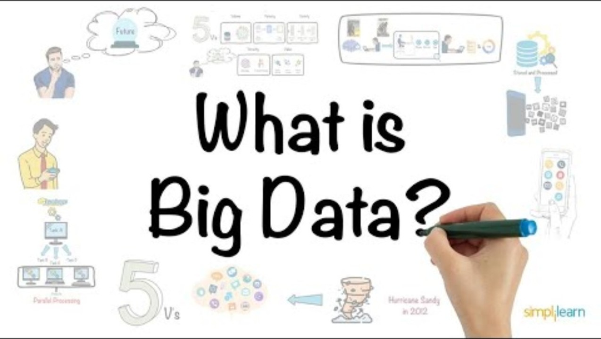
What Is Big Data?

Slide 5

Definition
Big Data Analysis The process of handling, analyzing, and extracting valuable insights, trends, patterns, and relationships from large, complex, and diverse datasets.
Goal To extract useful information from data that supports decision-making and predicts future developments.

Slide 6
Characteristics（1／3）
Volume
Big data involves a massive amount of data, often reaching petabytes (PB) or exabytes (EB), beyond the capability of traditional data processing tools.
Example
Social media platforms generate billions of pieces of data daily.
Velocity
Big data is produced and updated in real-time, requiring immediate processing and analysis.
Example
Stock market data changes rapidly and needs to be analyzed in real-time for decision-making.

Slide 7
Characteristics（2／3）
Variety
Big data comes in various formats, including structured data (like relational databases), semi-structured data (such as JSON or XML), and unstructured data (like text, images, and videos).
Example
A business collects data from customer transactions, social media feedback, and customer service interactions.

Slide 8

What is Big Data Analytics?

Slide 9
Characteristics（3／3）
Veracity
Big data has varying degrees of accuracy and reliability, requiring data cleaning and validation before analysis.
Example
Web-scraped data might contain errors, requiring cleanup to ensure valid analysis.
Value
The primary goal of big data analysis is to extract valuable insights from the data to support business decisions, improve operations, and uncover opportunities.
Example
Analyzing customer behavior data helps businesses improve sales strategies.

Slide 10


Real-life Applications（1／2）
Social Media Analysis
Healthcare
Businesses use data from social media platforms to target marketing efforts and understand consumer preferences.
Example Analyzing customer comments to adjust product strategies and improve offerings.
Big data analysis helps predict disease risks and improve treatment outcomes by analyzing patient health data.
Example Healthcare organizations use big data for early disease detection and personalized treatment.

Slide 11


Real-life Applications（2／2）
Smart Cities and Traffic Management
Financial Services
Big data analysis helps manage city infrastructure, such as traffic, energy consumption, and public services.
Example Smart traffic systems adjust traffic signals in real-time based on traffic flow to reduce congestion.
In finance, big data helps assess credit risk, detect fraud, and make investment decisions.
Example Banks use big data to analyze customers' spending behaviors and offer personalized loan products.

Slide 12
Importance（1／2）
Improved Decision-Making
Big data allows businesses to make data-driven decisions rather than relying on intuition or past experiences, improving operational efficiency.
Example
Retailers analyze purchasing behaviors to optimize inventory management.
Enhanced Business Competitiveness
Big data helps identify market opportunities, optimize marketing strategies, and enhance business competitiveness.
Example
E-commerce platforms recommend personalized products to users, boosting sales conversion rates.

Slide 13
Importance（2／2）
Creation of New Business Models and Opportunities
Big data analysis uncovers new business opportunities or product innovations that weren’t possible before.
Example
Location-based services provide real-time taxi booking services based on customer proximity.

Slide 14
Challenges to Solve（1／2）
Data Privacy and Security
Protecting sensitive data is crucial to avoid data breaches or misuse.
Example
Social media platforms have faced data breaches, highlighting the need for stronger security measures.
Data Quality and Accuracy
Ensuring data accuracy and quality is vital for valid analysis and decision-making.
Example
Inaccurate data can negatively impact predictive models and lead to incorrect business decisions.

Slide 15
Challenges to Solve（2／2）
Data Integration and Collaboration
Big data comes from diverse sources and formats, requiring integration and coordinated processing.
Example
Businesses face challenges in combining data from multiple systems (e.g., CRM, ERP, social media) for analysis.
Skill and Talent Shortages
There is a growing demand for data scientists, analysts, and engineers with expertise in big data technologies.
Example
The shortage of skilled professionals in the big data field has created a high demand for qualified talent.

Slide 16
Summary
Big data analysis is a crucial technology that helps businesses improve efficiency, identify opportunities, and support decision-making across various industries. Despite challenges like data privacy, data quality, and the need for skilled professionals, ongoing technological advancements will continue to address these issues, making big data analysis even more integral to modern business strategies.

Slide 17
Big Data Visualization

Slide 18
Definition
Big Data Visualization The process of converting vast and complex datasets into graphs, charts, or dynamic dashboards to help users intuitively grasp trends, relationships, and anomalies within the data.
Goal To make complex data easily understandable, thereby supporting informed decision-making and problem-solving.

Slide 19
Characteristics（1／3）
Intuitiveness
Transforms abstract data into an easily comprehensible visual format, facilitating the identification of patterns and outliers.
Example
A bar chart comparing sales across regions to quickly highlight top-performing areas.
Interactivity
Allows users to filter or zoom into specific data points to access more detailed information.
Example
Interactive dashboards enable users to click on indicators to view additional details.

Slide 20
Characteristics（2／3）
Variety
Supports multiple types of visual representations, such as line charts, pie charts, scatter plots, and heat maps.
Example
Using a line chart for trends and a pie chart to show proportional data from the same dataset.
Dynamic Nature
Updates in real time to reflect the latest data changes.
Example
A stock market dashboard that continuously displays real-time price fluctuations.

Slide 21
Characteristics（3／3）
Simplicity
Filters and streamlines data to emphasize key metrics, reducing information overload.
Example
A well-designed dashboard displays only the most critical business indicators.

Slide 22

Real-Life Applications（1／2）
Business and Market Analysis
Healthcare
Companies use visualization to analyze sales trends, inventory, and customer behavior data.
Example Retailers monitor promotional campaign results through visual charts to adjust marketing strategies.
Medical institutions utilize visualization to present patient data, enhancing diagnosis and treatment planning.
Example Hospitals display patient health indicators in charts to assist doctors in developing treatment plans.

Slide 23

Real-Life Applications（2／2）
Financial Services
Smart Cities and Traffic Management
Visual tools help analyze market trends, assess risks, and manage asset allocation.
Example Banks monitor real-time portfolio performance on dashboards for effective risk management.
Visualization aids in analyzing urban traffic, energy consumption, and public service efficiency.
Example Traffic departments use heat maps to identify congestion areas and adjust signal timings accordingly.

Slide 24
Importance（1／2）
Enhanced Data Understanding and Decision Efficiency
Visual representation transforms abstract data into clear insights, enabling rapid decision-making.
Example
Dynamic charts help management quickly identify business bottlenecks and adjust strategies.
Facilitation of Data Sharing and Team Collaboration
Clear visuals make it easier to share data insights across departments, promoting coordinated actions.
Example
Shared dashboards enable teams to align their goals and work collaboratively.

Slide 25
Importance（2／2）
Support for Forecasting and Risk Management
Trend analysis and anomaly detection through visualization help identify potential risks and opportunities early.
Example
Financial institutions use visualization tools to monitor unusual transactions and prevent fraud.

Slide 26
Challenges to Overcome（1／2）
Data Overload and Information Filtering
Identifying the most valuable data within massive datasets to avoid overwhelming users.
Example
Overcrowded dashboards can confuse users if too much irrelevant data is displayed.
Data Quality and Accuracy
Inadequate data cleaning and processing can lead to misleading visualizations and poor decisions.
Example
Inaccurate raw data can skew visualization results, affecting the overall analysis.

Slide 27
Challenges to Overcome（1／2）
Tool and Technology Requirements
Effective visualization requires the right tools and technical expertise to design impactful displays.
Example
Creating an intuitive, interactive dashboard demands significant investment in professional software and skilled personnel.
User Experience and Interactive Design
Designing an interface that is both intuitive and not overly complex.
Example
Overly complicated filtering options may confuse users and diminish the effectiveness of the visualization.

Slide 28
Summary
Big Data Visualization is a critical technique for transforming complex data into clear visual insights, facilitating better understanding, decision-making, and collaboration. Despite challenges such as data overload, quality control, and technical demands, ongoing technological advancements are expanding its applications across various industries, making it an essential tool in modern data analysis and decision support.

Slide 29
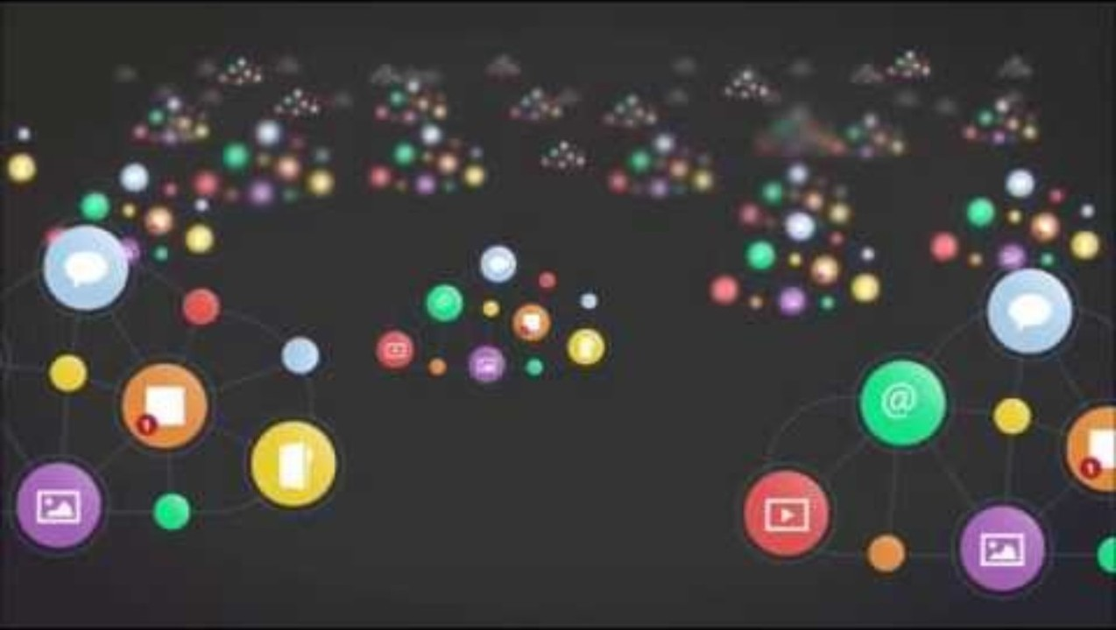
Big Data and Data Visualization

Slide 30
Methods, Techniques, and Tools for Big Data Visualization

Slide 31
Methods（1／2）
Static Chart Display
Uses fixed charts (e.g., bar charts, line charts, pie charts) to show historical data and trends.
Suitable for reports and documents that present specific metrics.
Dynamic Dashboards
Presents real-time data with interactive dashboards that allow filtering, zooming, and live updates.
Commonly used in enterprise decision support systems and real-time monitoring.

Slide 32
Methods（2／2）
Geographic Visualization
Combines data with geographic information, displaying regional differences and spatial distribution on maps.
Ideal for traffic management, sales distribution, and monitoring epidemics.
Network and Relationship Graphs
Displays the connections and network structures within data, such as in social network analysis.
Helps in understanding community structures and relationship patterns.
Exploratory Data Analysis
Combines statistical analysis with visualization to help users identify patterns, anomalies, and trends from large datasets.
Useful for data preprocessing, clustering, and trend prediction.

Slide 33
Techniques（1／2）
Data Preprocessing and Cleaning
Involves data aggregation, sampling, and noise reduction to handle vast and messy raw data.
Dimensionality Reduction
Uses methods like Principal Component Analysis (PCA) or t-SNE to project high-dimensional data into a lower-dimensional space for easier visualization.
Machine Learning and Deep Learning
Employs clustering, classification, and regression techniques to extract patterns from data, which can then be visualized.

Slide 34
Techniques（2／2）
Interactive Design Techniques
Uses front-end technologies (such as JavaScript, HTML5, and CSS) to create interactive experiences between users and data.
Real-Time Data Processing
Utilizes stream processing frameworks (e.g., Apache Kafka, Apache Spark Streaming) to process and display data in real time.

Slide 35
Tools（1／2）
Professional Visualization Platforms
Tableau：User-friendly, ideal for enterprise dashboards and business intelligence analysis.
Power BI：A Microsoft product that easily integrates with other office tools, suitable for small and medium-sized enterprises.
Programming Languages and Libraries
Python：Common visualization libraries include Matplotlib, Seaborn, Plotly, and Bokeh, which are ideal for custom and in-depth data analysis.
R：Uses packages like ggplot2 and Shiny for data visualization and building interactive applications.

Slide 36
Tools（2／2）
Web-Based Visualization Technologies
D3.js：A powerful JavaScript library for creating highly customizable interactive web visualizations.
Echarts：Developed by Baidu, suitable for quickly building dynamic charts and dashboards.
Big Data Processing Platforms
Apache Zeppelin / Jupyter Notebook：Combines coding and visualization, ideal for data exploration and model demonstration.
QlikView / Qlik Sense：Data discovery and visualization platforms that support enterprise-level data analysis and sharing.

Slide 37
Summary
These methods, techniques, and tools form a complete framework for big data visualization. They help users in various fields extract valuable insights from vast and complex datasets and present them in an intuitive manner, ultimately supporting decision-making and business optimization.

